Slide 1
Plan-And-Document Perspective on Performance, Releases, Reliability, and Security
Engineering Software as a Service §12.10

Slide 2
P&D on the 4 Issues?
Does Plan-and-Document address performance issues?
Anything special about Plan-and-Document releases?
P&D Standards for Quality?
Are the reliability and security challenges similar in Plan-and-Document?
Can unreliability lower security?

Slide 3
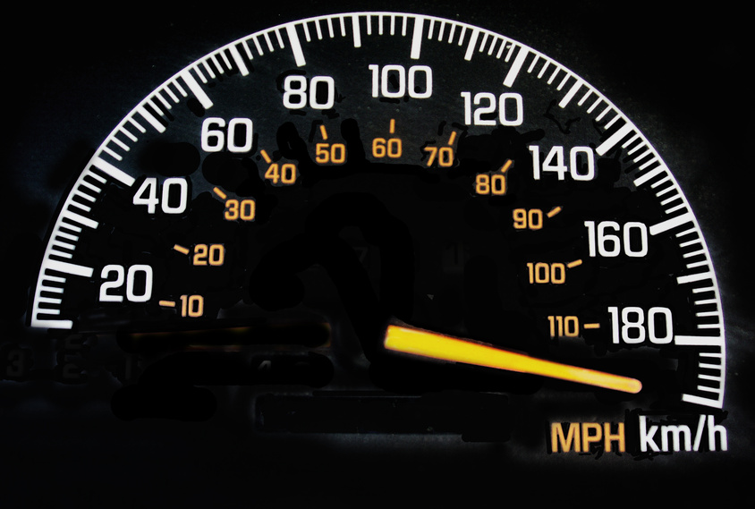
P&D and Performance
Like reliability and security, performance considered a non-functional requirement
Can be part of acceptance tests
Plan-and-document lifecycles ignore performance because
Performance optimizations often excuse for bad SW engineering practice
Covered in other books/courses

Slide 4
P&D and Release Management
Special case of configuration management
P&D releases include everything: code, configuration files, data, and documentation
P&D releases number scheme: e.g., Rails version 3.2.12
.12 is minor release
.2 is major release
3 so large a release that it can break APIs, must re-port app

Slide 5
P&D and Reliability
Dependability via redundancy
Guideline: no single point of failure
How much redundancy can customer afford?
Mean Time To Failure (MTTF) includes SW and operators as well as HW
Unavailability ≈ Mean Time To Repair/MTTF
Improving MTTR may be easier than MTTF, but can try to improve both MTTR and MTTF

Slide 6

P&D and Security
Reliability relies on probabilities, but security must defend against intelligent opponents
Common Vulnerabilities and Exposures database list typical attacks: cvedetails.com
Some reliability improving techniques prevent attacks:
Buffer overflows, arithmetic overflows, data races
Penetration tests can test security
Notes:
intelligent opponents exploiting unexpected event
Checking the inputs to ensure that that the user is not sending too much data can prevent Buffer overflow attacks
Checking input values or catching exceptions might prevent Arithmetic overflow attacks.
Concurrent programming flaws are much harder to detect and correct

